Slide 1

ss
ext here
Revenue Analysis by Ishe Anopa consultants

Slide 2

Table of Content
I. Presentation overview.
II. Data processing systems.
iii. Data Intelligence
01
IV. Project Execution Plan
V. Analytics driven strategic recommendations
VI. Stakeholder Q & A
02

Slide 3
Presentation overview
Summary
Mandated to conduct a comprehensive sales analysis for Bright Coffee Shop, using transactional data captured between 1 January 2023- 30 June 2023. The project was undertaken to transform raw data into actionable business intelligence to support decision making at executive level
The primary objective is not only to report historical performances , but extract insights that inform incoming execs vision to scale and grow the business sustainably. The findings highlighted key opportunities for revenue optimisation, customer behaviour and operational improvements, creative growth initiatives designed to strengthen Bright market position.

Slide 4
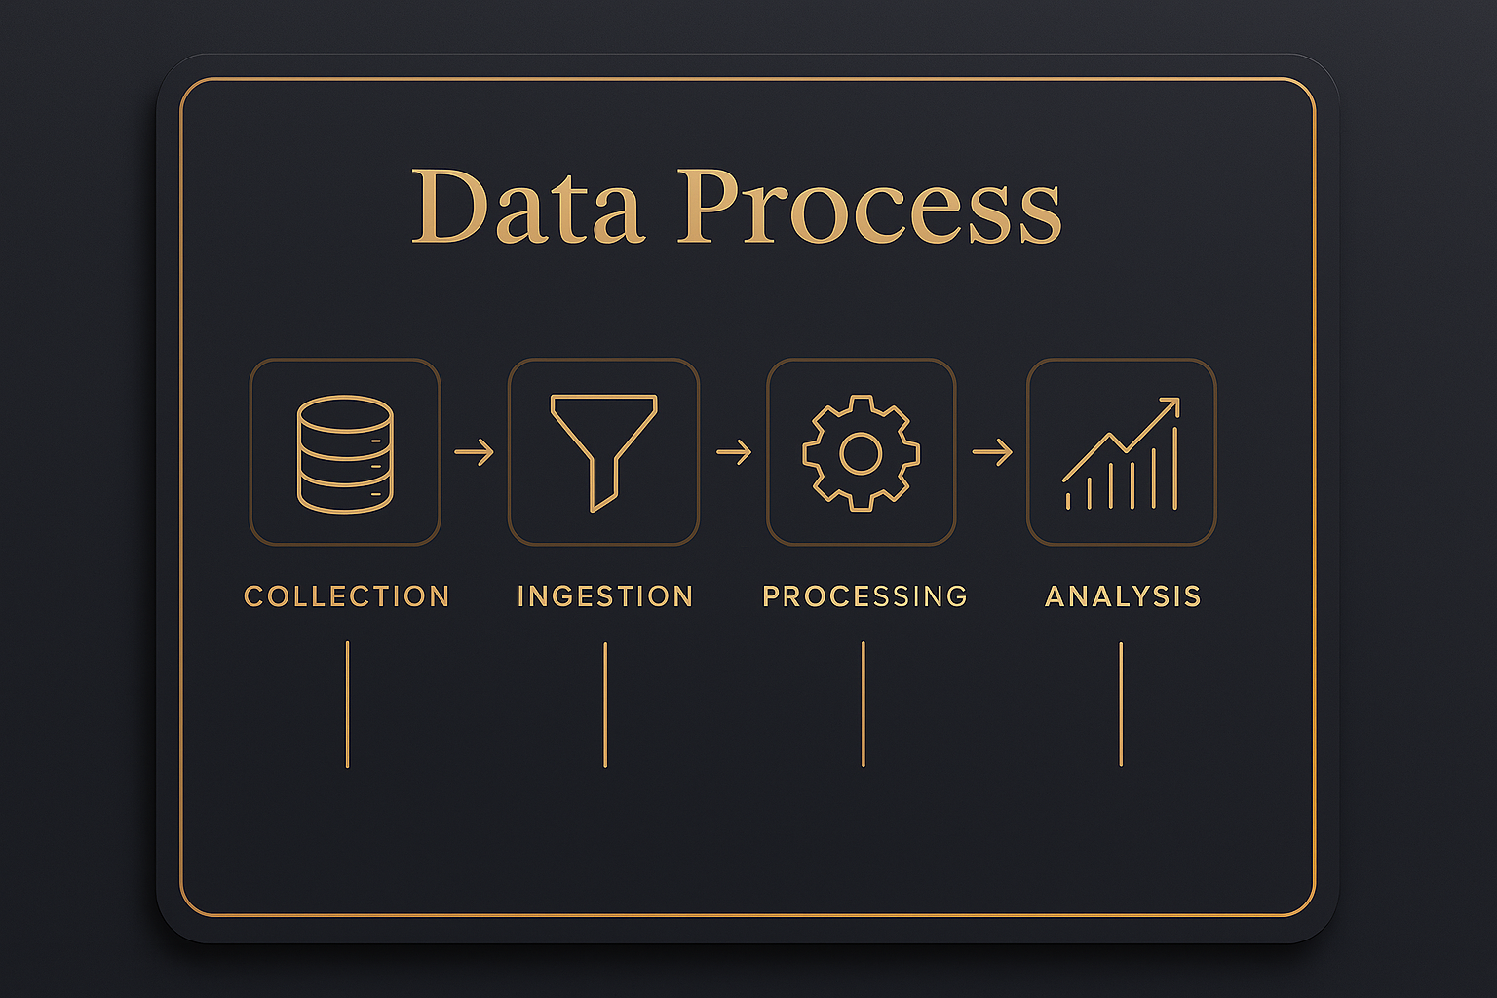
Data processing system.
Data sourced from Microsoft Excel.
Dataset ingested into the Databricks environment as Csv file.
A manual ETL process was followed .
SQL was used in Databricks to clean and transform the data.
New Columns created, including transaction time buckets to group transactions into time intervals.
Data types such as unit price were correctly cast.
Total transaction amount was calculated( unit_price * transaction_qty.
Key metrics such as total revenue per product were derived.
Processed data was exported to MS excel for pivoting and further analysis.
Clean datasets stored in Databricks.
Final insights into Powerpoint presentation

Slide 5
Total sales in all locations rose steadily , with lower M - and Hells K, climbing from roughly 27k in Jan to about 56k in June. H.K consistently generates the highest monthly sales . L.M slags slightly behind the other two outlets in most months
Revenue across all 3 locations vs name of month
e

Slide 6
sales peak in the morning bucket and generates the highest total sales across all stores, indicating that the business captures the strongest revenue window early in the day. Some stores exhibit stronger evening sales, implying location- specific demand patterns.
Total sales vs Time_ bucket and store location

Slide 7
Total sales vs product category and time intervals
Peak sales hours in the morning making it the most profitable time of day. Showing the strongest sales in that period making $388288.67 followed by the afternoon with sales up to $204720.83

Slide 8
The pie chart illustrates the % contribution to total sales by each location, with Hell’s kitchen slightly ahead generating the highest revenue amongst the three

Slide 9
Results show that the top-performing product is Sustainably Grown Organic Lg within the drinking chocolate category (hot chocolate) , achieving $21,151,75 in total revenue from 4,453 units sold.

Slide 10
The lowest- performing product is in the packaged chocolate category, specifically within the drinking chocolate product type. The dark chocolate variant generated total revenue of $4722.20 , with 118 units sold

Slide 11
Distribution of products sales across the 3 locations highlight clear location- driven differences in category demand. L.M demonstrates stronger and more diversified product movement , indicating a mature, high- volume customer base that responds well to broad assortment. In contrast , Astoria and H.K. show more selective categories performance, suggesting localized preferences and untapped growth potential rather than overall demand weakness

Slide 12
Sales patterns across all three Bright Coffee shop locations show a clear and consistent demand concentration in the morning period, with afternoons as a secondary peak. This may indicate that customer traffic is primarily driven by routine, time bound consumption behaviors –such as morning commutes ,workday starts and early productivity rituals- rather than discretionary or leisure-based visits later in the day.

Slide 13
The graph highlights the top-selling products . Popular beverages include Dark chocolate (Large), sustainably organic (Large), latte (Regular), and morning sunrise chai (Large), among others. Hot chocolate- dark chocolate ranks amongst best selling items overall

Slide 14
Over a six-month – period, Bright coffee generated total revenue of $698,812.13 from a beverage and other - portfolio of more than 80 products. All three locations are performing satisfactorily, with seasonal variations in individual sales remaining relatively small. In the next section , we present strategic recommendations aimed at increasing revenue, enhancing service efficiency, and driving overall business performance

Slide 15

Recommendations and Strategy to drive revenue

Slide 16
Strategy and recommendations
Optimise peak-hour revenue
Ruthless menu rationalisation / focus on performers
Smart pricing and hype to unlock emerging products
Reengineer morning operations to maximise throughput, speed and volume.
Redesign staffing schedules, barista workflows and counter layouts to reduce service time per customer.
Introduce express lanes, pre-order pick-ups or limited “morning only” menus focused on top sellers
Increase availability, visibility and consistency of best- selling items.
Gradually phase out products with persistently low demand to reduce waste, supplier complexity and staff training time and costs.
Temporary introductory pricing- half price or bundle offers to build awareness and trial. Promote the low performing products aggressively at point of sale and on digital channels.
Once demand is established, gradually normalise pricing to protect margin

Slide 17
Reposition physical space
The revenue pattern confirms that customers currently view Bright primarily as a grab and go coffee shop. However this presents a significant growth opportunity, not limitation.
Redesign sections of each store to support remote work, informal meetings and longer stays.
Improve wi-fi seating comfort, power access and lighting.
Introduce subtle cues that position Bright as a productive third space for professionals and students
Consider closing earlier in the evenings and reallocating resources to earlier opening times, capturing more of the high-value morning demand.
Alternatively , test evening specific offerings rather than forcing coffee sales when demand is naturally low.
Simple engagement through a digital ordering app provides clear insights into customer preferences.

Slide 18
Auto reporting systems
Point of sale + Inventory
BI dashboards
Alerting stack.
This is a non negotiable. A modern café pop that gives us real time sales reporting, menu performance, staff reporting and ideally inventory tracking and customer profiles/ loyalty.
Toast
Lightspeed
Square etc.
Pull POS data into BI tool and running standardised dashboards that compare store apples to apples for instance.
Automated alerts so you don’t have to check reports.
Inventory and purchasing automation –stop wasting money on slow sellers
This is just to mention a few

Slide 19
Thoughts
In today’s business environment, revenue is shaped by far more than the product alone. Market trends, perception and influence now play a defining role in consumer decision- making. Customers often buy into the idea, image and promise of a brand before they experience the product itself. Hype created attention, premium branding builds desire and a clear unique selling proposition differentiates– ultimately, influence is what converts interest into demand. When a business is strategically positioned and supported by intentional, well-executed marketing campaigns, sustainable growth follows.

Slide 20
Therefore:
The true product is not coffee itself , but speed, efficiency and excellence in service. These are the real value driver in a coffee business. The beverage is expected; the experience is what differentiates.
-End-

Slide 21

Q & A session

